Slide 1

DSST289: Introduction to Data Science
Welcome!
T. ARNOLD

Slide 2
1. Brief Overview
T. ARNOLD

Slide 3
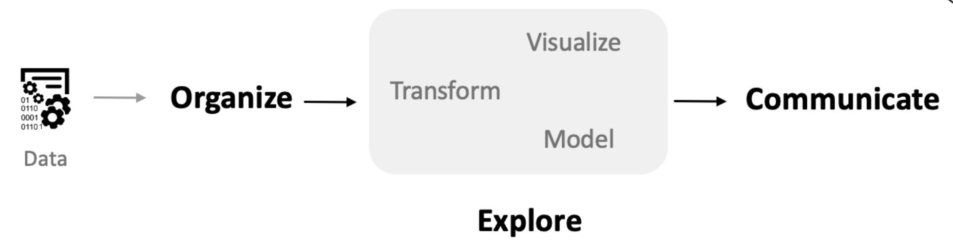
Data Science Pipeline
A standard, highly abstract diagram showing the flow of information when doing data science work.
T. ARNOLD

Slide 4
Data Science Pipeline
A standard, highly abstract diagram showing the flow of information when doing data science work.
We are going to learn how to do all of these elements using a variety of tools, including spreadsheets (data collection) and Python (most of the other steps) as well as some custom hardware/software for certain kinds of data.
T. ARNOLD

Slide 5
2. Syllabus
T. ARNOLD

Slide 6
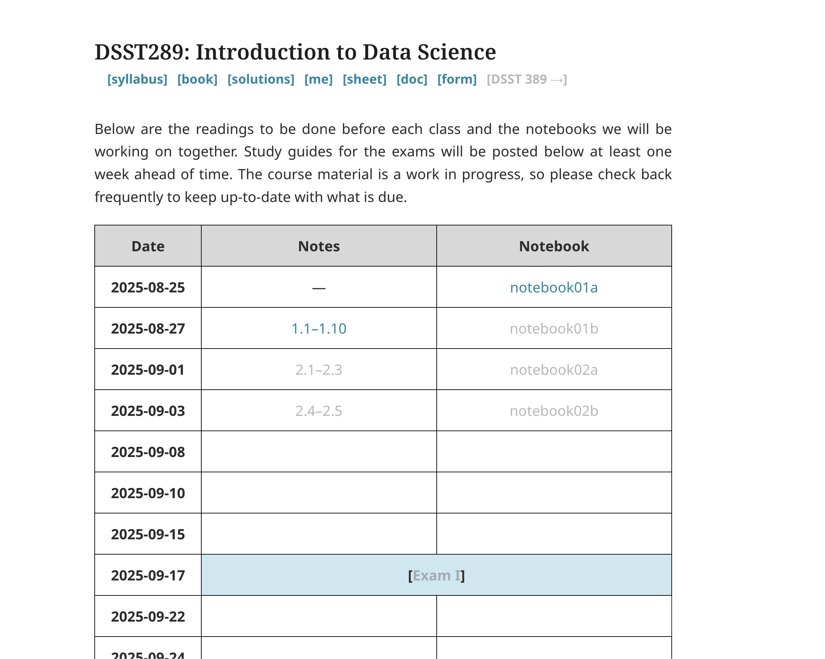
Course Structure
All of the notes and materials that you need this semester can be found on the public course website:
taylor-arnold.github.io/courses/dsst289-f25/
Let’s go through a few of these elements.
T. ARNOLD

Slide 7
Course Structure
Prior to each course meeting, you should do the reading assigned in the Notes section on the website.
T. ARNOLD

Slide 8
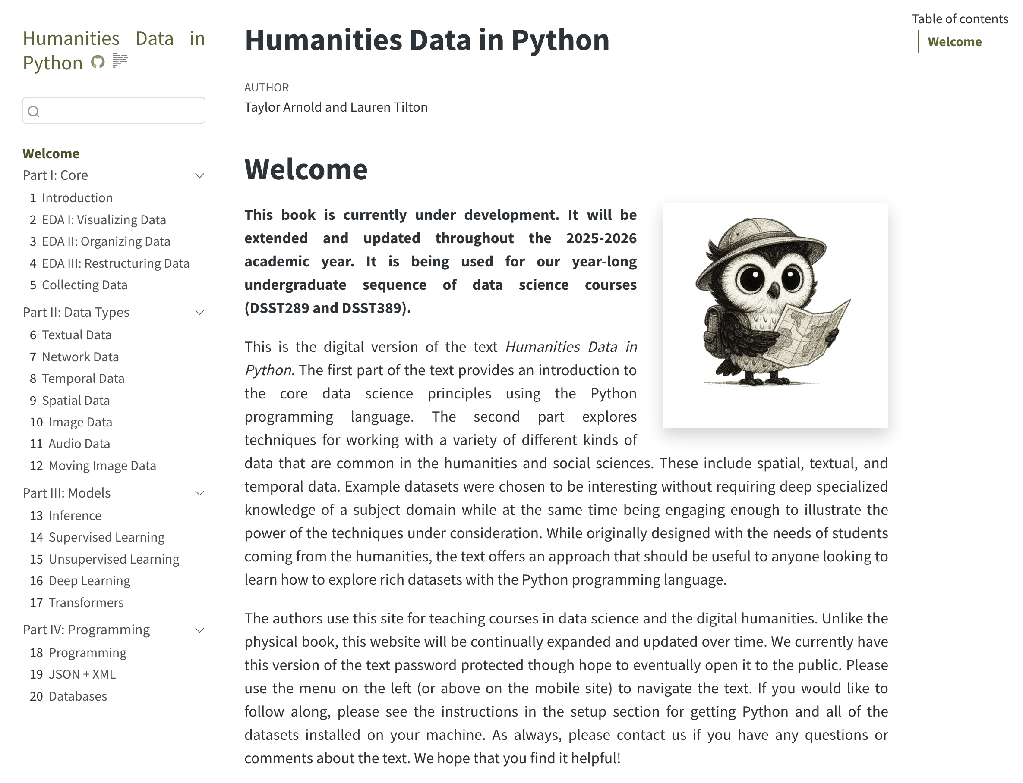
Course Structure
Most readings will come from the book Humanities Data in Python. I am in the middle of writing this and will be making changes throughout the semester.
And don’t worry, it’s not just for the humanities!
T. ARNOLD

Slide 9
Course Structure
There is also a direct link at the top of the page to the book.
T. ARNOLD

Slide 10
Course Structure
At the start of class, we will fill out the course form together. This is a form of checking attendance and sometimes doing a bit of data collection.
T. ARNOLD

Slide 11
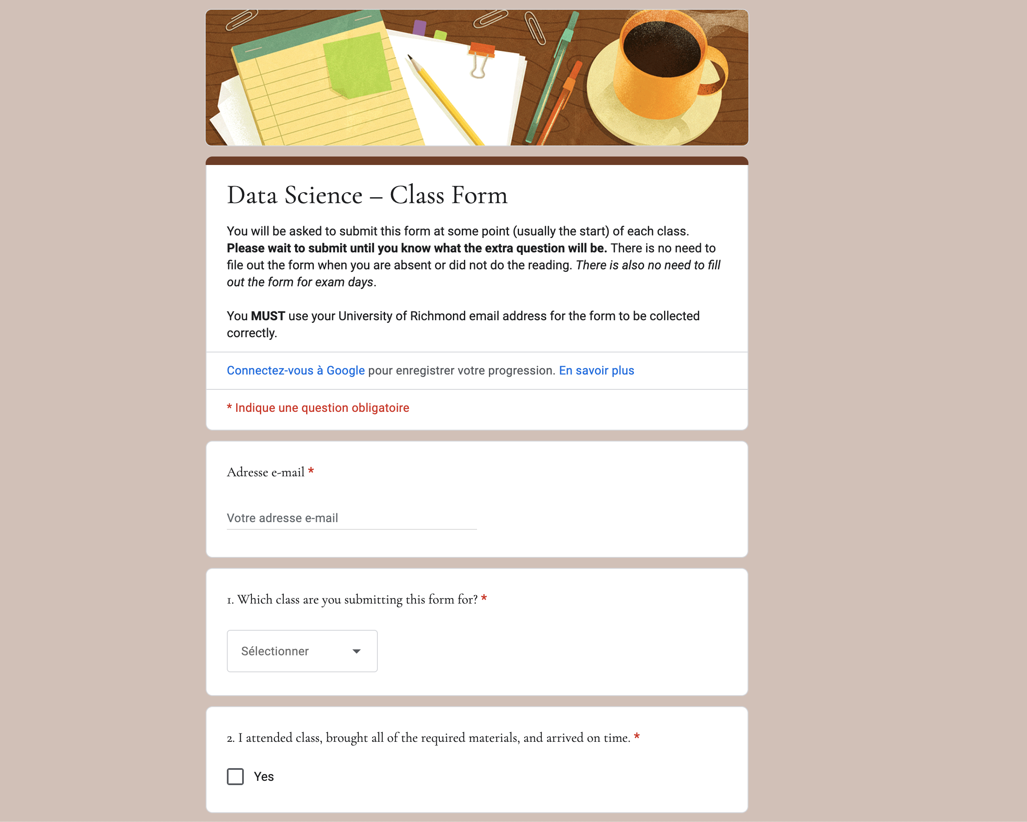
Course Structure
At the start of class, we will fill out the course form together. This is a form of checking attendance and sometimes doing a bit of data collection.
It will ask you whether you are in class, whether you’ve done the reading, and sometimes asks for some extra information.
T. ARNOLD

Slide 12
Course Structure
During class, we will spend most of our time going through a Notebook (coding) together and/or doing some data collection.
These are neither submitted nor graded.
T. ARNOLD

Slide 13
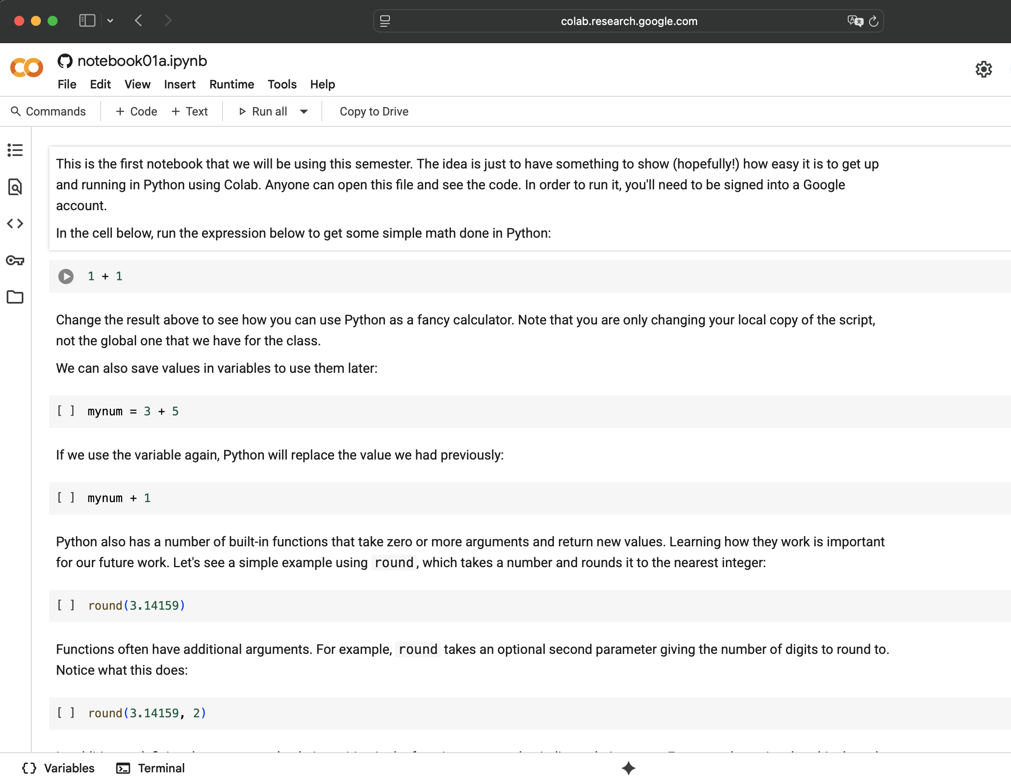
Course Structure
During class, we will spend most of our time going through a Notebook (coding) together and/or doing some data collection.
These are neither submitted nor graded.
T. ARNOLD

Slide 14
Course Structure
Solutions will be posted at the solutions page, linked to at the top of the page.
T. ARNOLD

Slide 15
Course Structure
We will have four exams on the days listed on the course website (spread out more-or-less evenly through weeks 2-12).
T. ARNOLD

Slide 16
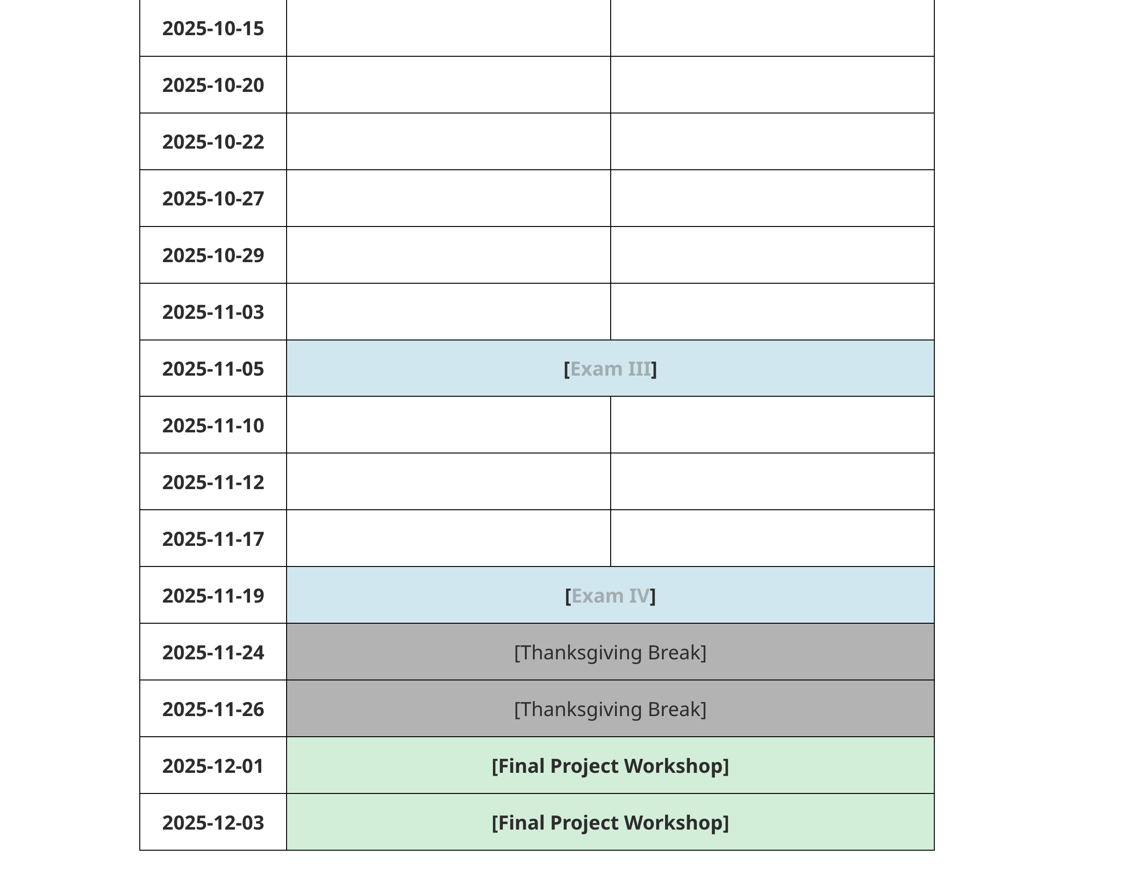
Course Structure
In the final week of the semester, we will do a final project. More details on that soon.
T. ARNOLD

Slide 17
Grading
I try to keep grading simple. You’ll get a grade for exam exam, your class forms (100% - 5% for each missing form beyond 2), and your final project. These six grades are averaged, and a letter grade is assigned as follows:
A (93–100), A- (90–92),
B+ (87–89), B (83–86), B- (80–82),
C+ (77–79), C (73–76), C- (70–72)
F (0–69)
T. ARNOLD

Slide 18
Generative AI
I assume you are getting a lot of different rules/advice about using generative AI in all of your classes. We are actually going to be studying it here, so prepare to hear a lot more!
For the actual work this semester, you are welcome to Gen AI in any way you would like outside of class. During class, refrain from the temptation to have the technology answer your questions for you. I shouldn’t see any ChatGPT, Claude, Gemini, Grok … or similar running on your machine while we are working together in class unless there has been a specific instruction to do so.
T. ARNOLD

Slide 19
3. Back to the Class Form
T. ARNOLD

Slide 20
Class Form
For the extra question today:
What is your previous background with R/Python/programming/spreadsheets?
None is totally fine! And if you have a lot, no need for an exhaustive list. Just trying to get a sense for everyone's background
T. ARNOLD

Slide 21
4. Our First Notebook
T. ARNOLD

Slide 22
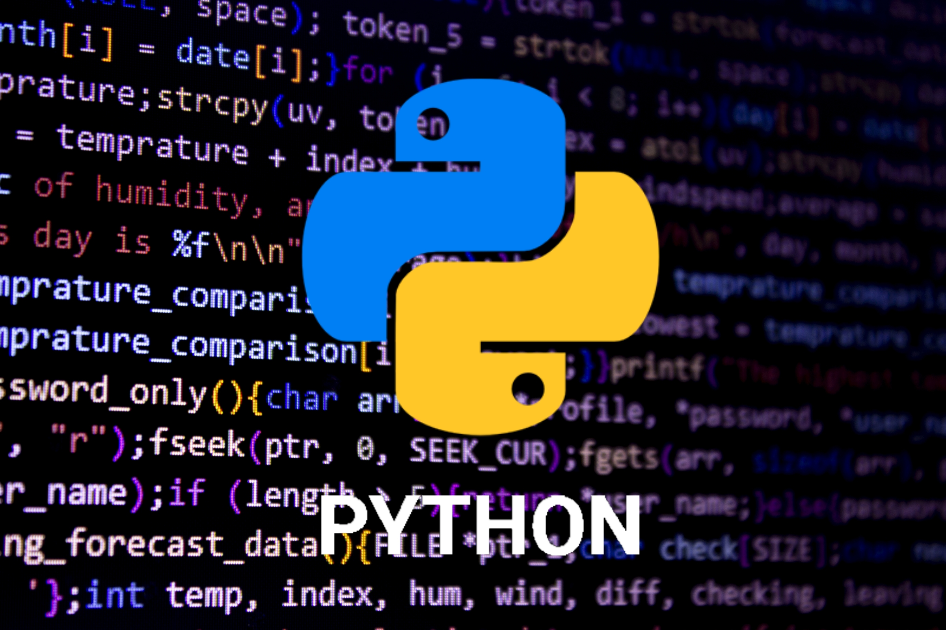

Python
A big change this semester is that I am transition this class from R to Python, for a number of inter-related reasons. The core content is the same, but Python let’s us do some extra things (machine-learning related, largely) that were tricky in R. It will also allow us to run code through Google Colab instead of requiring a setup on your machine. While we are using the Google product, everything you learn can be applied to any version of Python that you want to make use of.
T. ARNOLD

Slide 23
5. A Bit of Data
T. ARNOLD

Slide 24
Recipe
Let’s do a little data work today to start thinking about the core questions of data science.
On a piece of paper, write down a recipe for a favorite dish of yours. Something moderately complicated (around 5-10 ingredients) is perfect.
Include the ingredients and instructions for how to make it.
T. ARNOLD

Slide 25
Recipe
As you read the section for next class, consider what it would take to create a tabular version of your recipe as a structured dataset. Consider how we could create a large dataset of hundreds or thousands of these.
What if we needed a way to do things such as detect recipes that are vegetarian, vegan, kosher, gluten free? What if we wanted to calculate how to scale up/down you version? Convert from/to metric? Figure out what things you could make with a certain ingredient?
Think about all of these things as a concrete example as you read for Wednesday’s class!
T. ARNOLD

